Slide 1
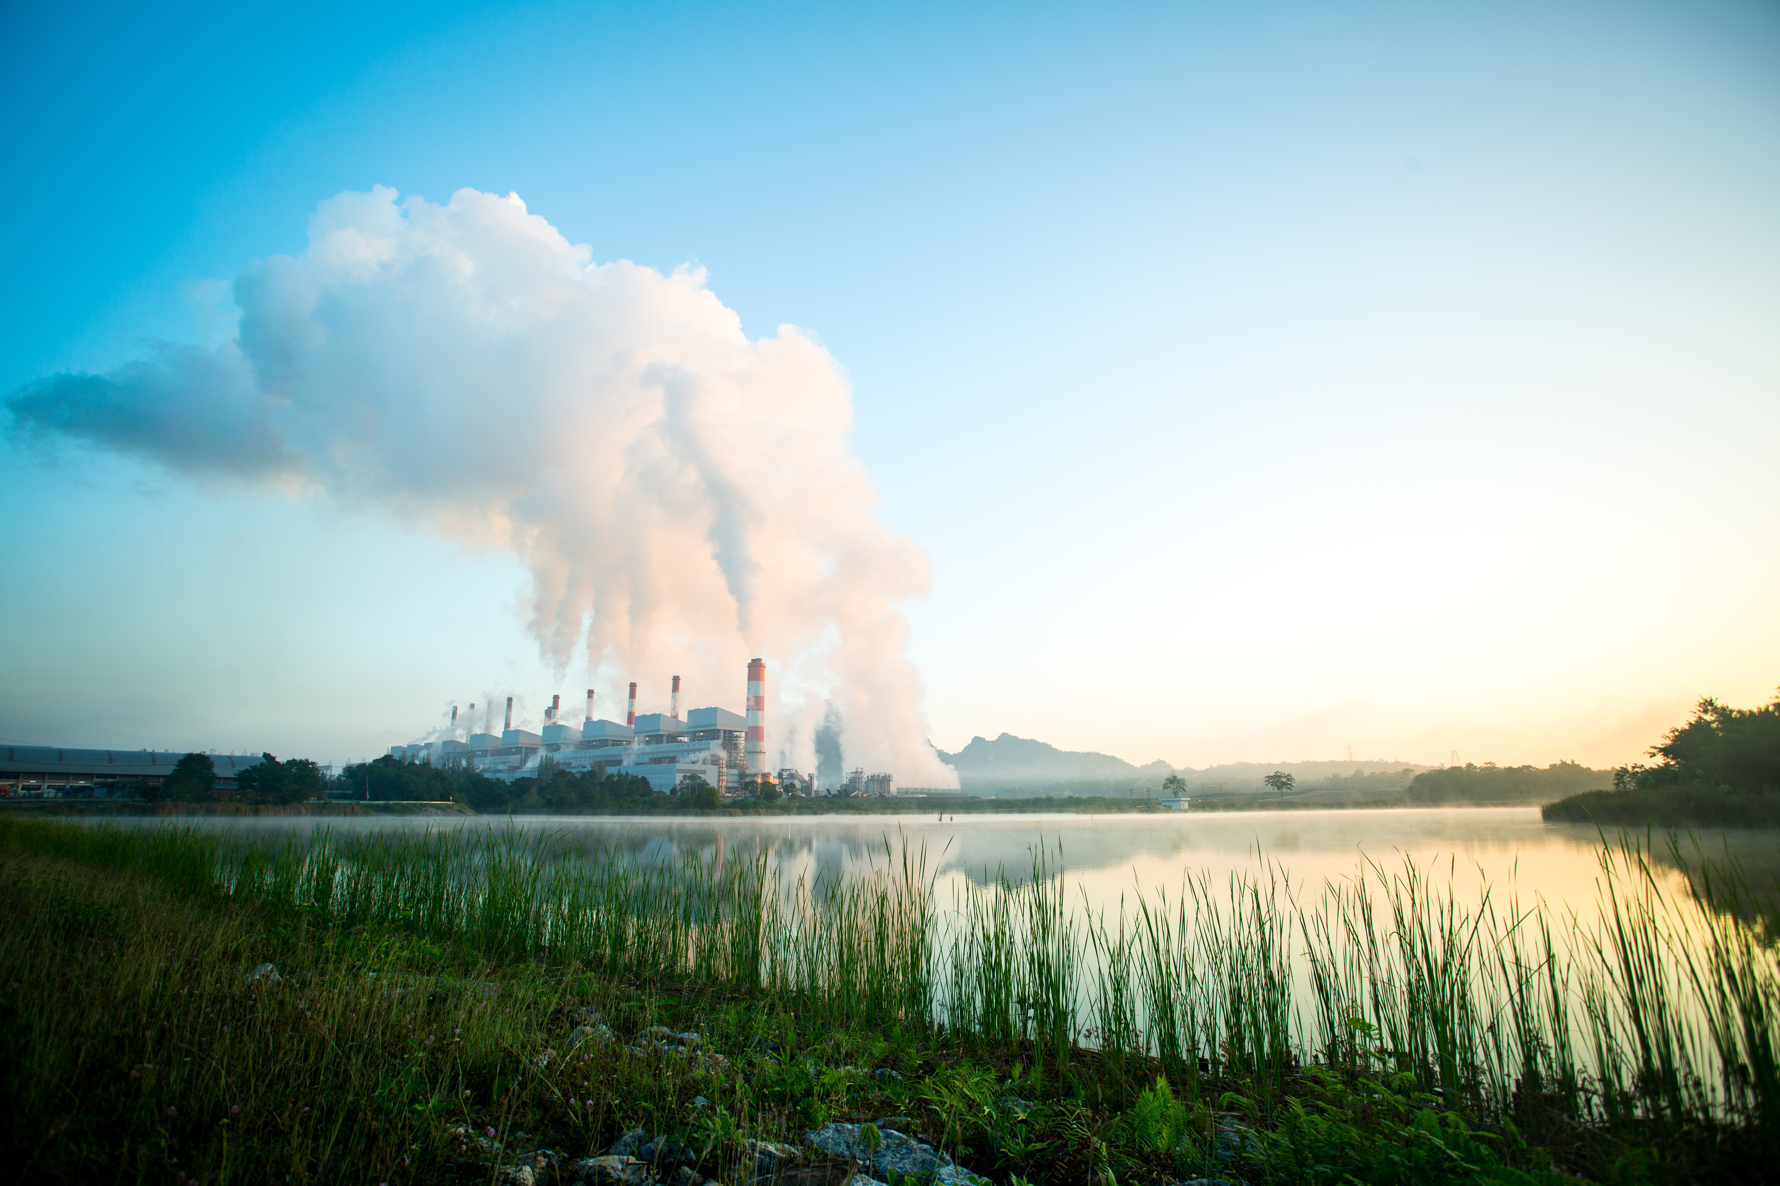

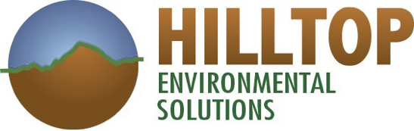
Unconventional Soil Disposal Options
Chris Reitman, Veronica Foster, and Tim Fogerty
May 2019

Slide 2
Agenda
Soil Sources
Conventional and Unconventional Disposal Options
NJ Alternative Fill Requirements
Beneficial Use Alternatives
Understanding Best Alternatives
Further Information on Site Specific Conditions

Slide 3
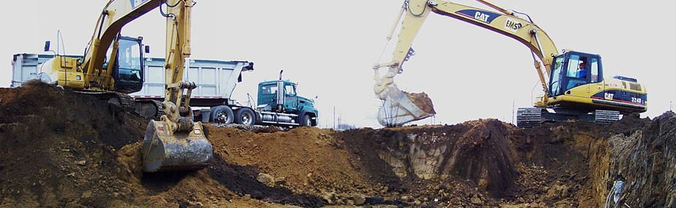
Soil and Waste Sources
Spills
Demolition
Small waste streams
On-site remedial activities
On-site excavations in industrialized areas
Historical Fills
Cleaning out industrial equipment
May be generated regularly or intermittently Volume of material impacts viable alternative disposal options

Slide 4
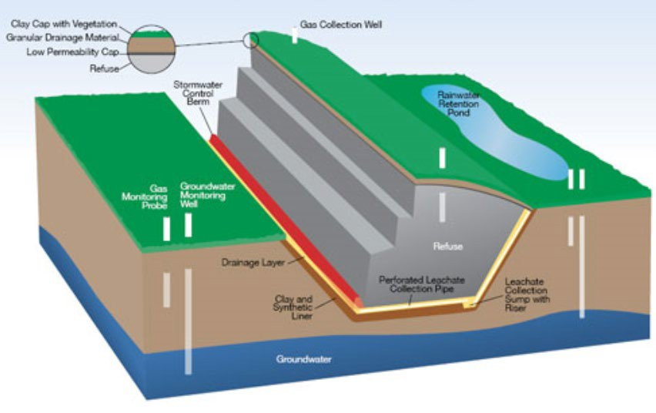
Conventional Disposal Options
Landfilling Options
  On-site Residual Waste LFs
  Local Municipal LFs (commercial and debris)
  Regionally located Landfills/ Treatment facilities with limited
treatment capabilities for metals
  Hazardous LFs
Thermal treatment
  Remove organics and either reuse or send to landfill

Slide 5
Unconventional Options
Unconventional Landfilling Options
  LFs may also allow material to be beneficially used as cover fill if inert (beneficial use)
Quarry Fills
  Regulated by state agencies for Mine Reclamation
Beneficial Use (non-cover fill)
  Cement Additives for pozzolanic materials
  Fertilizer
  Structural and grading fills
  Stabilization
  Other beneficial uses (kitty litter, agricultural, etc.)
State Fill Program

Slide 6
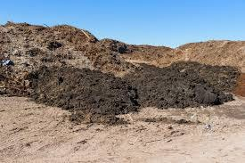
State Fill Programs
Delaware – Beneficial Use Determination
Maryland – Case-by-Case basis
Pennsylvania – Act 2 Site Remediation Program
NJ Alternative Fill Guidance (remediation and filling through Site Remediation Recovery Act (SRRA) Licensed Site Remediation Professional {LSRP})

Slide 7

NJ Alternative Fill Program
Contaminants in the fill can exceed normal residential/ non-residential soil remediation standards
Does not contain free liquids or product
Material can be
  soil or non-soil
  from on-site or off-site

Slide 8
NJ Fill Guidance Considerations
Like-on-like – Limits types of contamination to those present
75th Percentile – Material added cannot be overall higher
concentration to the material already present. May also use 95% on the mean.
Statistical analysis is used to demonstrate “weighted concentrations” do not exceed across site-specific maximum concentrations. Provides flexibility to meet standards.
Volume Limits – Must be part of a remediation or overall grading plan
This approach eliminates the need for use of clean fill for certain types of fill

Slide 9
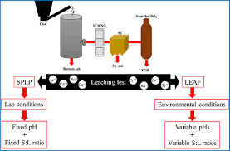

Screen for Potential Groundwater Impacts
Less than NJDEP default levels (Impact to Groundwater
{IGW} screening levels)
If greater than IGW default screening levels
  Must pass SPLP (synthetic precipitation leaching procedure)
  Other approved procedures

Slide 10
Exclusions
PCBs (>10 ppm)
Asbestos
RCRA Waste
Dioxin
Radiological materials

Slide 11
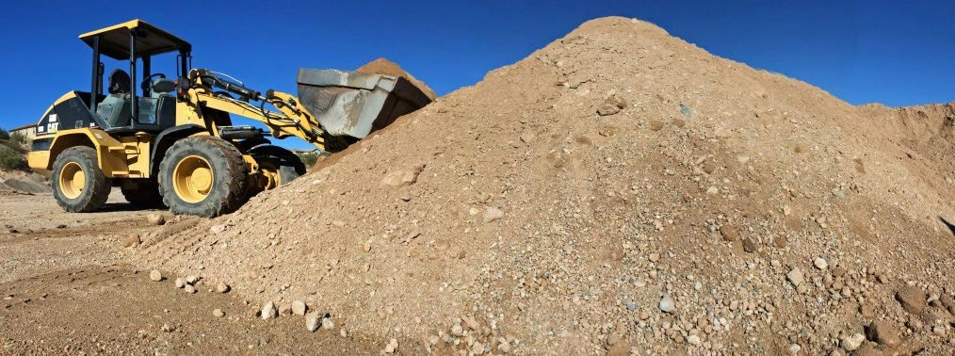
Fill Characterization Needs
Characterization data varies per site – Developed by overseeing LSRP
Generally need to understand metals/organics present
Generally understand whether it will leach based on IGW or site specific SPLP testing
Testing frequency in accordance with Sampling Plan developed by LSRP for each Site

Slide 12
Example 1 – Beneficial Use at Brownfield Site
Background: Brownfield sites needing soil to raise the grades or to cap contaminated soil below
Management: Each site has a specific acceptance protocol. Some sites can accept up to 10 ppm for Benzo- a-pyrene and other PAHs.
Lead levels up to 800 ppm
Benefits include reduced overall disposal costs and reduced imported clean fill costs. Typical savings may be 50% reduction on direct landfilling and 25% reduction on transportation, if located near generator site.

Slide 13
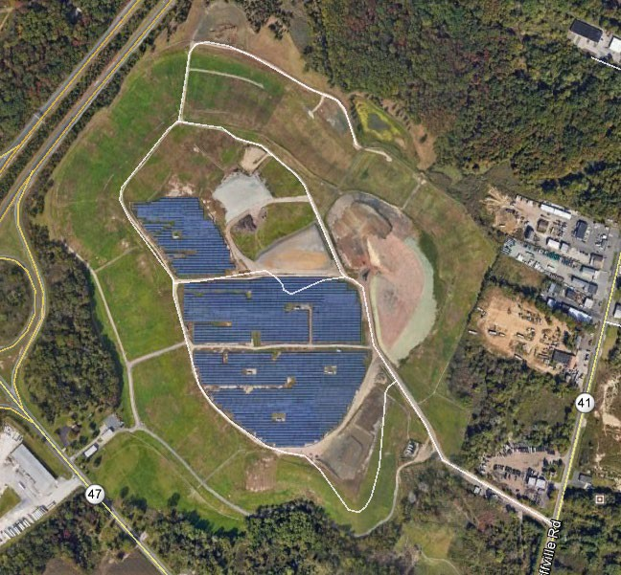
Example 2 – Cap Maintenance Old NJ Landfill
Background: State has old landfills that require maintenance and/or closure. Some are orphaned sites. Differential settlement is occurring at older sites (pre-1990 engineering).
Traditional cap maintenance in NJ would use clean soil to complete the cap
Alternative acceptance fill allows a site to use impacted material as grading fill to address settlement/low spots. Allows redevelopment.
These sites can take soils with elevated levels of Arsenic (<100 ppm), Lead (<1000 ppm)< and PCBs (<10 ppm).

Slide 14

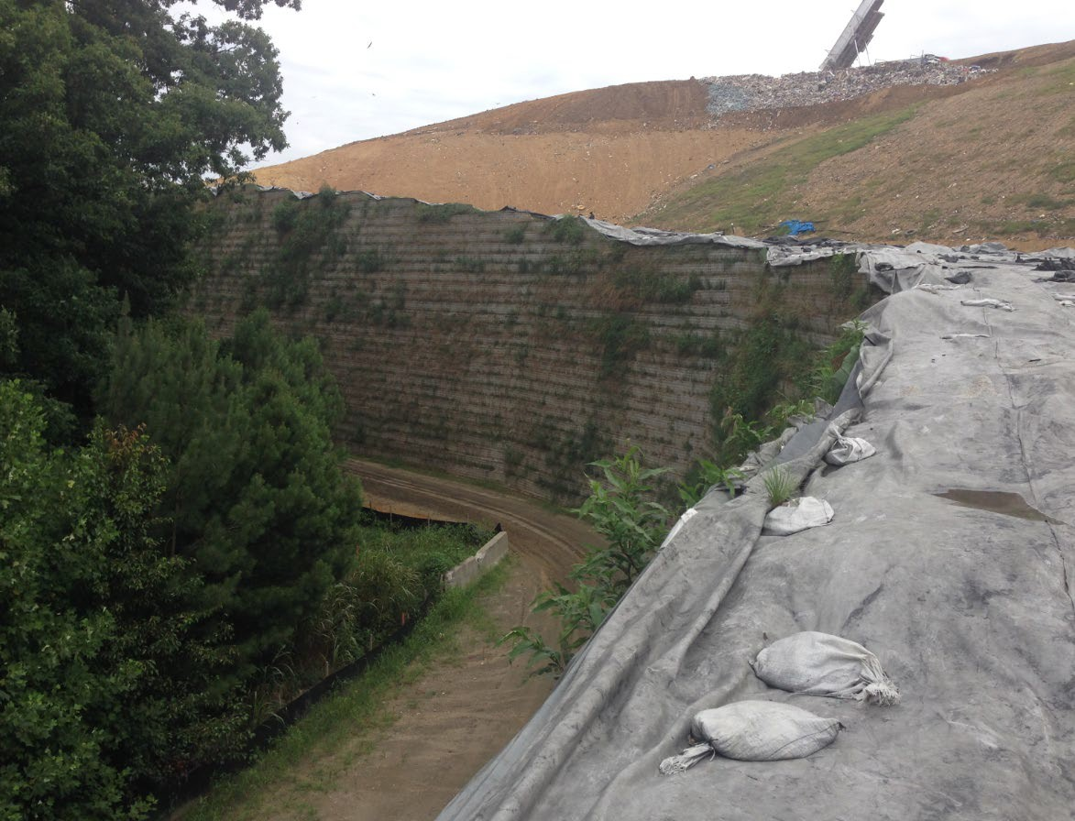
Example 3 - MSE Wall
Mechanically Stabilized Earth (MSE) Wall uses granular fill and geosynthetics to create near vertical wall
Contaminated soils are being uses as the fill to help construct the walls
For this project, the MSE Wall was constructed with contaminated soil, incinerator ash and fly ash. The contaminated materials are completely encapsulated, allowing elevated levels of all metals, VOCs, SVOCS

Slide 15
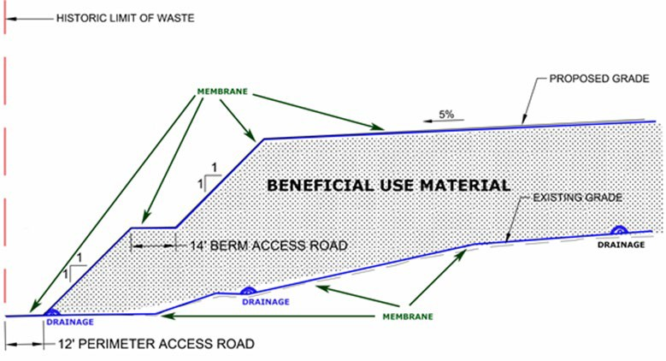
Example 3 - MSE Wall (cont.)
Inherent benefit for the use of MSE Wall for this project is increased airspace/disposal volume
Granular materials are best for this type of application
12

Slide 16
Summary on Dealing with These Materials
Talk to brokers early in process
Understand whether waste is recurring or not
Understand the volume to material you expect
Characterize waste
Look at different state programs, they can vary considerably

Slide 17

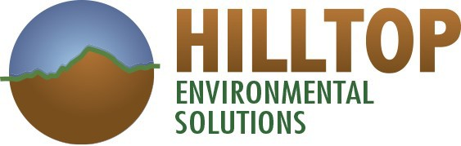
Thank you for your time and attention!
Questions?
Chris Reitman
Veronica Foster
Rick Shoyer
Al Silkrowski
Tim Fogerty

